Slide 1

JAVA PROGRAMMING
Exception Handling
Mr. Nilesh B. Ghavate
Technical Trainer
B.Tech CSE AIDS Department

Slide 2
Lesson Plan
Subject/Course | Java Programming/ Exception Handling in Java
Lesson Title | Exception Handling
Lesson Objectives
Errors and Exceptions
try-catch Block , finally Block
throw and throws Keywords
Custom Exceptions , Exception Handling Best Practices

Slide 3
Outline
Errors and Exceptions
Checked and Unchecked Exceptions
try-catch Block
Multiple catch Blocks
finally Block
throw and throws Keywords
Custom Exceptions
Exception Handling Best Practices

Slide 4
Introduction to Exception Handling
An exception is an unexpected event that occurs during program execution.
It interrupts the normal flow of a program.
Exception handling allows us to detect and handle these problems.
It helps make programs reliable, robust, and user-friendly.
Java provides several keywords for handling exceptions:
  try
  catch
  finally
  throw
  throws

Slide 5
Advantages of Exception Handling
Prevents unexpected program termination.
Separates error-handling code from normal code.
Improves program reliability.
Makes debugging easier.
Provides meaningful error messages.
Helps maintain clean and readable code.
Allows programs to recover from certain runtime problems.

Slide 6
Disadvantages of Exception Handling
Makes code more complex
Using try, catch, finally, etc. can make programs longer and harder to read.
Performance overhead
Handling exceptions can be slower than normal program execution, especially when exceptions occur
frequently.
Difficult debugging
Poorly handled exceptions can hide the actual cause of a problem.
Too many exceptions can clutter code
Using many try-catch blocks can make the program difficult to maintain.
Improper handling may cause problems
If an exception is caught but ignored, errors may go unnoticed.

Slide 7
Errors and Exceptions
Errors
Serious problems that generally cannot be handled by the application.
Usually caused by the JVM or system environment.
Examples:
  OutOfMemoryError
  StackOverflowError
Exceptions
Problems that can often be detected and handled by the program.
Examples:
  ArithmeticException
  NullPointerException
  IOException

Slide 8
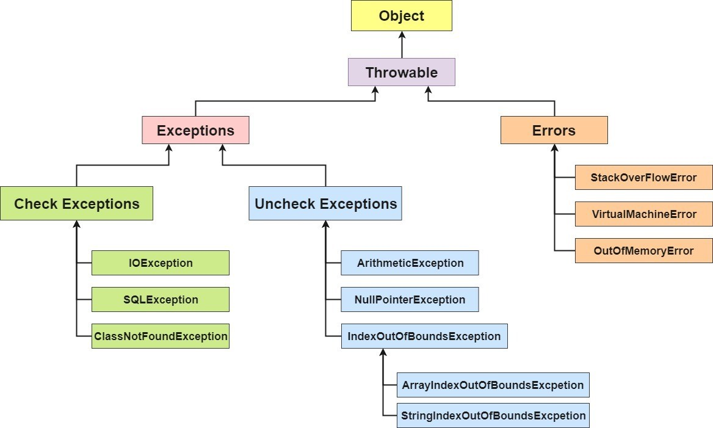

Slide 9
Checked Exceptions
Checked exceptions are checked by the compiler at compile time.
The programmer must either:
  Handle them using try-catch, or
  Declare them using throws.
Common examples:
  IOException
  SQLException
  FileNotFoundException
Example:
import java.io.*;
class Demo {
public static void main(String[] args) throws IOException {
FileReader f = new FileReader("data.txt");
}
}

Slide 10
Unchecked Exceptions
Unchecked exceptions occur mainly at runtime.
They are subclasses of RuntimeException.
The compiler does not require them to be explicitly handled.
Common examples:
  ArithmeticException
  NullPointerException
  ArrayIndexOutOfBoundsException
  NumberFormatException
Example:
int a = 10 / 0;
This causes ArithmeticException.

Slide 11
try-catch Block
The try block contains code that may cause an exception.
The catch block handles the exception.
This prevents abnormal termination of the program.
try {
int result = 10 / 0;
}
catch (ArithmeticException e) {
System.out.println("Cannot divide by zero");
}
Flow:
try ------→ exception occurs --------→ catch handles exception

Slide 12
Multiple catch Blocks
A single try block can have multiple catch blocks.
Each catch block handles a different type of exception.
More specific exceptions should generally be caught before broader ones.
try {
int[] numbers = {1, 2, 3};
System.out.println(numbers[5]);
}
catch (ArithmeticException e) {
System.out.println("Arithmetic error");
}
catch (ArrayIndexOutOfBoundsException e) {
System.out.println("Array index error");
}
catch (Exception e) {
System.out.println("Some other error");
}

Slide 13
finally Block
The finally block is used for cleanup operations.
It normally executes whether an exception occurs or not.
Commonly used to:
  Close files
  Release resources
  Close database connections
try {
System.out.println("Try block");
}
catch (Exception e) {
System.out.println("Exception occurred");
}
finally {
System.out.println("Cleanup code");
}

Slide 14
throw Keyword
The throw keyword is used to explicitly throw an exception.
It is useful when a programmer wants to create an exception based on a specific condition.
int age = 15;
if (age < 18) {
throw new IllegalArgumentException("Age must be 18 or above");
}
Key point:
throw is used to actually throw a specific exception object.

Slide 15
throws Keyword
The throws keyword is used in a method declaration.
It indicates that a method may pass an exception to its caller.
It is especially useful for checked exceptions.
void readFile() throws IOException {
FileReader file = new FileReader("data.txt");
}
Difference:
throw → explicitly throws an exception.
throws → declares possible exceptions.

Slide 16
Custom Exceptions
A custom exception is a user-defined exception.
It is created by extending Exception or RuntimeException.
Useful for application-specific errors.
class InvalidAgeException extends Exception {
InvalidAgeException(String message) {
super(message);
}
}
Using the custom exception:
if (age < 18) {
throw new InvalidAgeException("Not eligible");
}

Slide 17
Exception Handling Example
public class Example {
public static void main(String[] args) {
try {
int a = 10;
int b = 0;
int result = a / b;
System.out.println(result);
}
catch (ArithmeticException e)
{
System.out.println("Error: Division by zero");
}
finally {
System.out.println("Program completed");
}
}
}
Output:
Error: Division by zero
Program completed

